Slide 1

West Nile Virus in Chicago
A Kaggle Competitive Project
Freh Bayou, Ingrid Fitzgerald, Tad Inglesby & Sam Stack

Slide 2

Problem?
Portals to Africa opening in Chicago
Portals are very small
Mosquitoes are coming through portals.
Mosquitoes carry West Nile Virus.
(But they are so cute!)

Slide 3
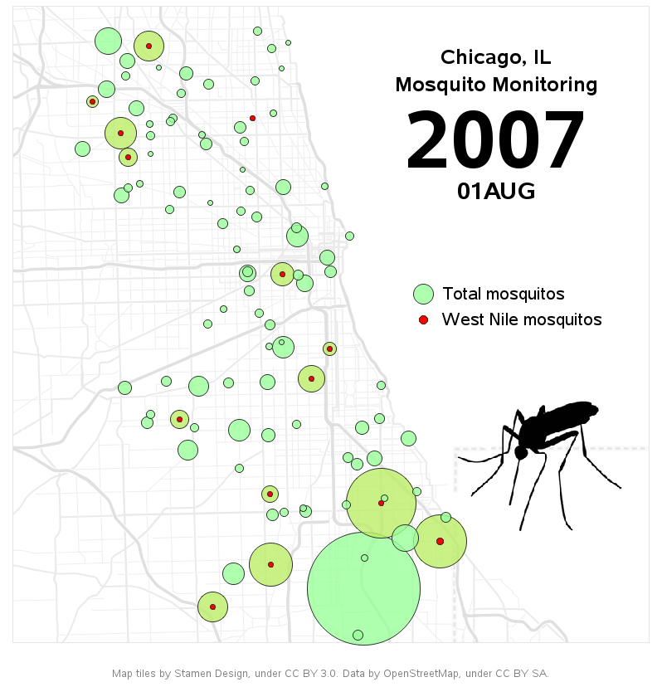
Objective.
Utilize the resources provided by Kaggle.com to create a model that could accurately predict where mosquitoes carrying The West Nile Virus are likely to appear.
Weather Data (2007-2014)
Bug Spray Data (2011 & 2013)
Chicago Mosquito Sampling Data (2007-2013)
Notes:
Image taken from http://www.allanalytics.com/author.asp?doc_id=277824
Author: Robert Allison

Slide 4
EDA and Data Refinement
Check and drop nulls
Identify Merge Points
Drop unneeded weather columns (like ‘Snow’)
Merged Weather and Train/Test
Did not use Spray*
Standard Scaler
Notes:
Upon further investigation of Spray Data, there was not enough information about how dense spraying occurred and how potent it lasted. Being that Venimex could last anywhere from 1-25 days and the coordinates provided where down to 10cm ranges.
Also data would not merge properly on using ‘Date’, ’Longitude’ and ‘Latitude’ features and was only available for 2 years.

Slide 5
Removed High Correlations
Address Accuracy and Longitude/Latitude Coordinates.
Culex Pipens, Culex Pipens/Restuans & Culex Restuans

Slide 6
Exploratory Modeling
Logistic Regression (Predicted only False) – 0.946
Support Vector Machine -0.856
K-Nearest Neighbors – 0.948
Normal Decision Tree 0.918 ± 0.006
Bagging DT Score: 0.939 ± 0.002
Random Forest Score: 0.94 ± 0.001
Extra Trees Score: 0.938 ± 0.002

Slide 7
“Dahm, Daniel!!! “
Almost all models performed very well as far as Accuracy!!! However…
Test set has 10506 rows and only 551 values.
Predicting ‘False’ for all rows would receive a .948 score.
Kaggle Judges using ROCAUC

Slide 8
Model Optimization
Grid Search for optimal Parameters
Recursive Feature Elimination for optimal Features.
(Non-conclussive)
Extra Trees Classifier, Feature Importance.

Slide 9
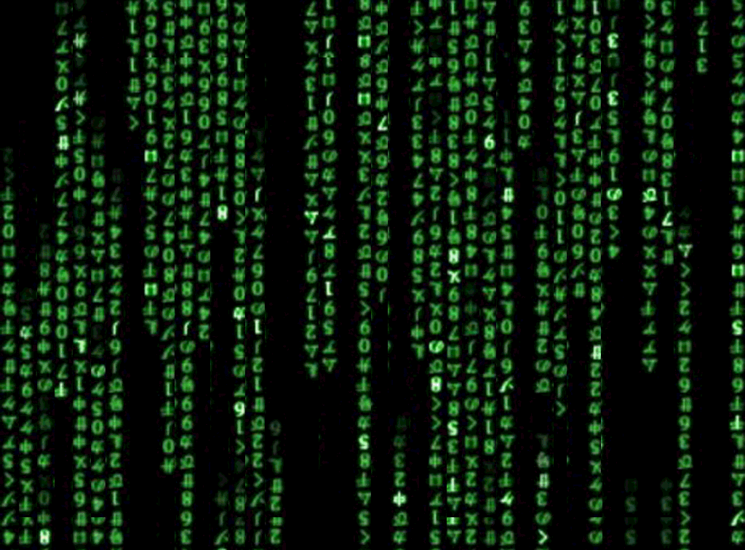
Enter the Neural Net.

Slide 10
Resources
https://www.kaggle.com/fchollet/predict-west-nile-virus/keras-deep-net-starter-code/code
https://github.com/Cardal/Kaggle_WestNileVirus/blob/master/WNV_Cardal.p
https://keras.io/models/sequential/
http://machinelearningmastery.com/5-step-life-cycle-neural-network-models-keras/

Slide 11
Neural Network Defining

Slide 12
Neural Net Base Model

Slide 13
 | AUC | Kaggle Results
Initial Neural Net | 0.884560 | 0.6063
Base NN | 0.789143 | 0.63887
Selected feature Neural Net | 0.760373 | 0.62
Best (Adjusted) Parameters Neural Net | 0.777082 | 0.69599

Slide 14
It is difficult to predict where mosquitoes will occur using independent elements. We Suspect that a Recursive Neural Network that treats elements as dependent on one another will perform much better.
Conclusion

